Slide 1
Marriote Bottle
Gimnazija Dubrovnik, Fun Physics

Slide 2
A Mariotte bottle is a device that provides a constant effusion velocity for liquids

Slide 3
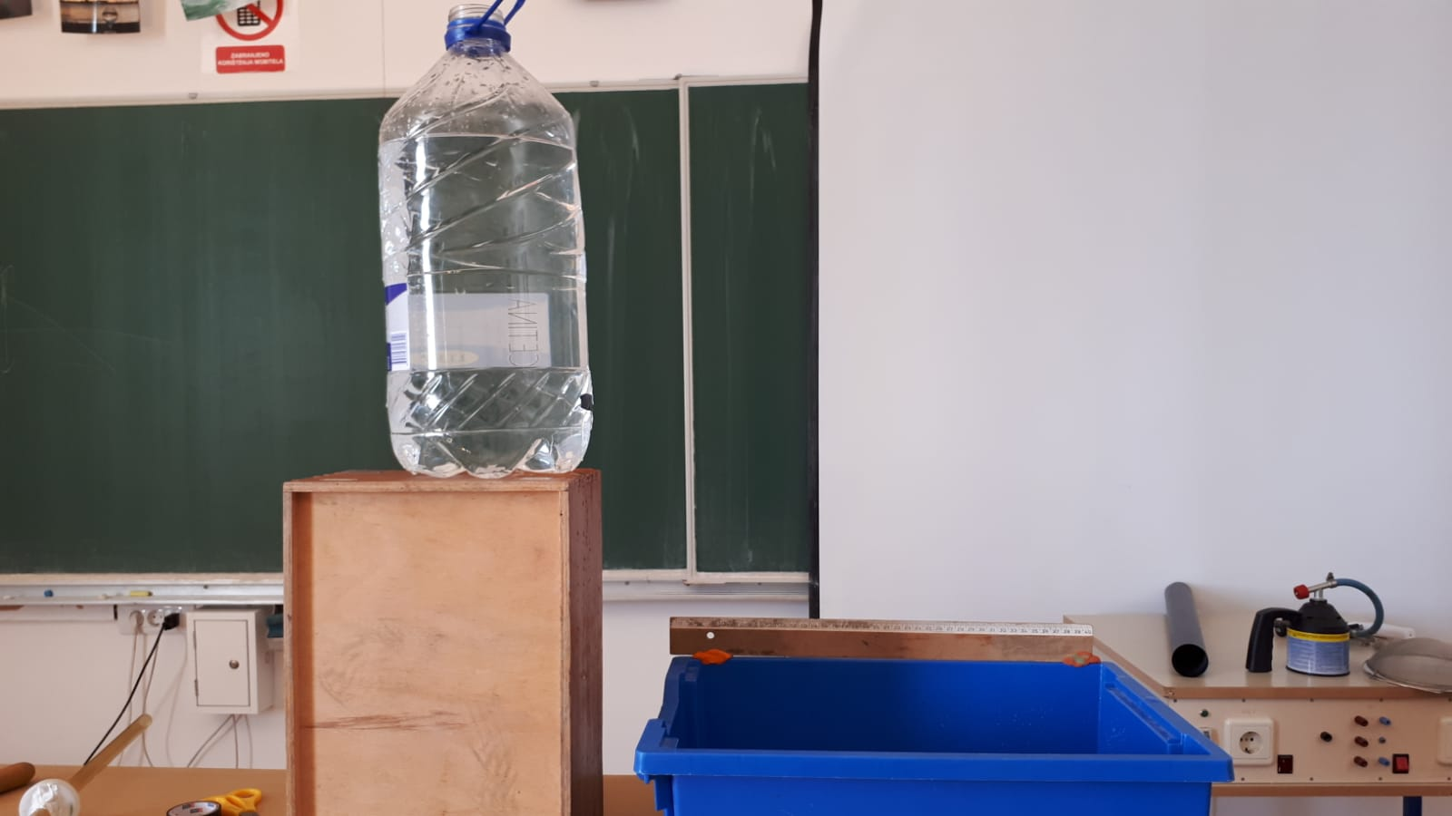
This is a normal bottle
Bottle has a small hole as you are about to see in the clip
Try to assume how the water will flow

Slide 4
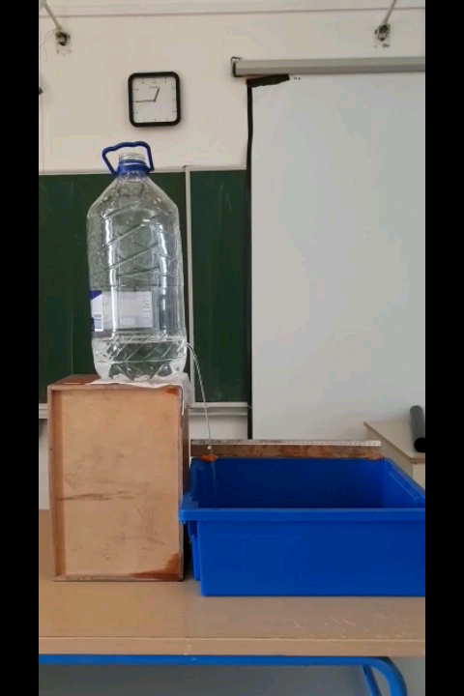
Video

Slide 5
Decreasing the water level reduces the range of water
That happens as hydrostatic pressure decreases with the drop of water height
Total pressure decreases as atmospheric pressure is always the same

Slide 6
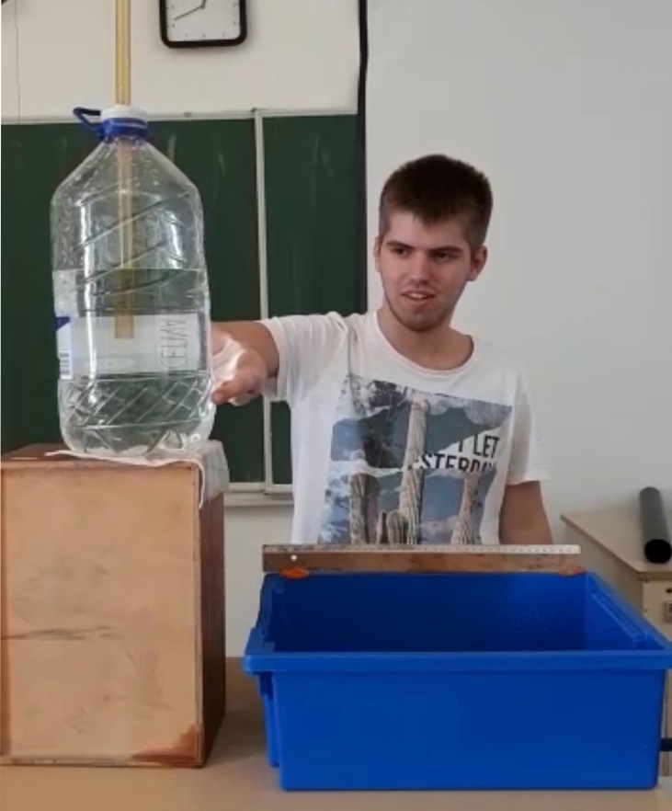
This is Marrinote bottle
It is the same as normal bottle but it has a tube put in it
Tube has to bi fixated with no space between it and the bottle top
The bottom of the tube has to be under the water level
Try to assume how the water will flow

Slide 7
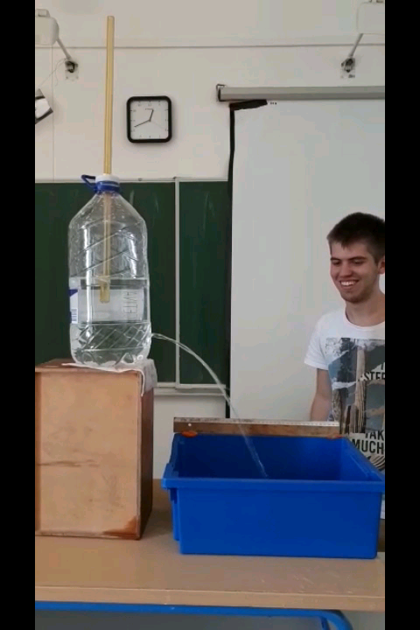
Video

Slide 8
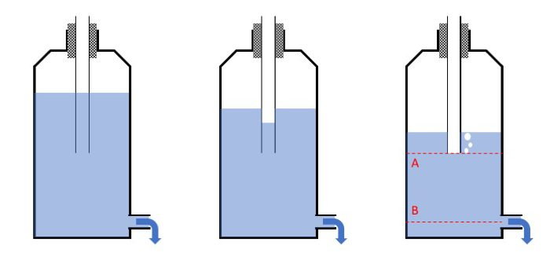
water flows out
the water level starts sinking
the pressure decreases
water level inside the pipe starts sinking
The pressure at level A is atmospheric
P _{atm}
P _{atm}
P < P _{atm}
P _{atm}
_{h}

Slide 9
Initially, when you fill and seal the bottle, water fills the tube to the same height as the level inside the bottle. Unless you fill the bottle completely with water, there is some air above the water, and the pressure at the bottom of the tube, P_{ref} = ρgh₀ + P_{space}, where ρ is the density of water, g is the acceleration of gravity, h₀ is the difference in height between the top of the water and the bottom of the tube, and P_{space} is the pressure in the space above the water. When the hole is opened, water flows out of the bottle until P_{space} falls to where it equals atmospheric pressure minus ρgh₀, the pressure exerted by the water column. At this point, the water inside the tube has fallen to the bottom of the tube, and the pressure at its bottom opening equals atmospheric pressure. (h₀, of course, decreases slightly during this process.)

