Slide 1
CORRUGATED PIPES
Karla Krmek, Gimnazija Dubrovnik 2019
Fun Physics

Slide 2
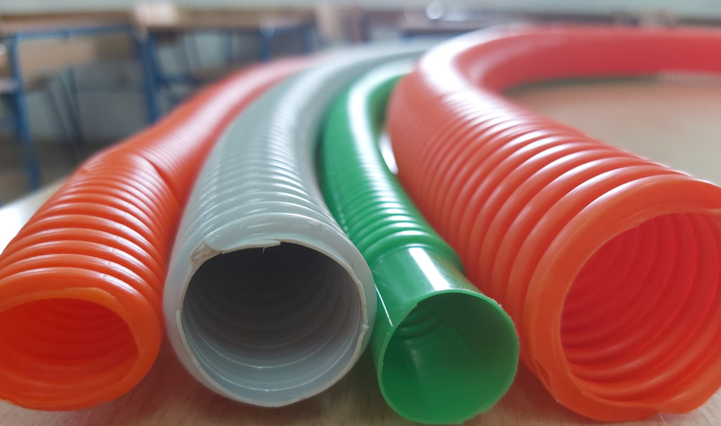
A corrugated tube open at both ends, with air flowing through it, emits sounds whose frequencies depend on the flow velocity and the length of the tube. The sounds it emits are the natural harmonics of the tube.

Slide 3
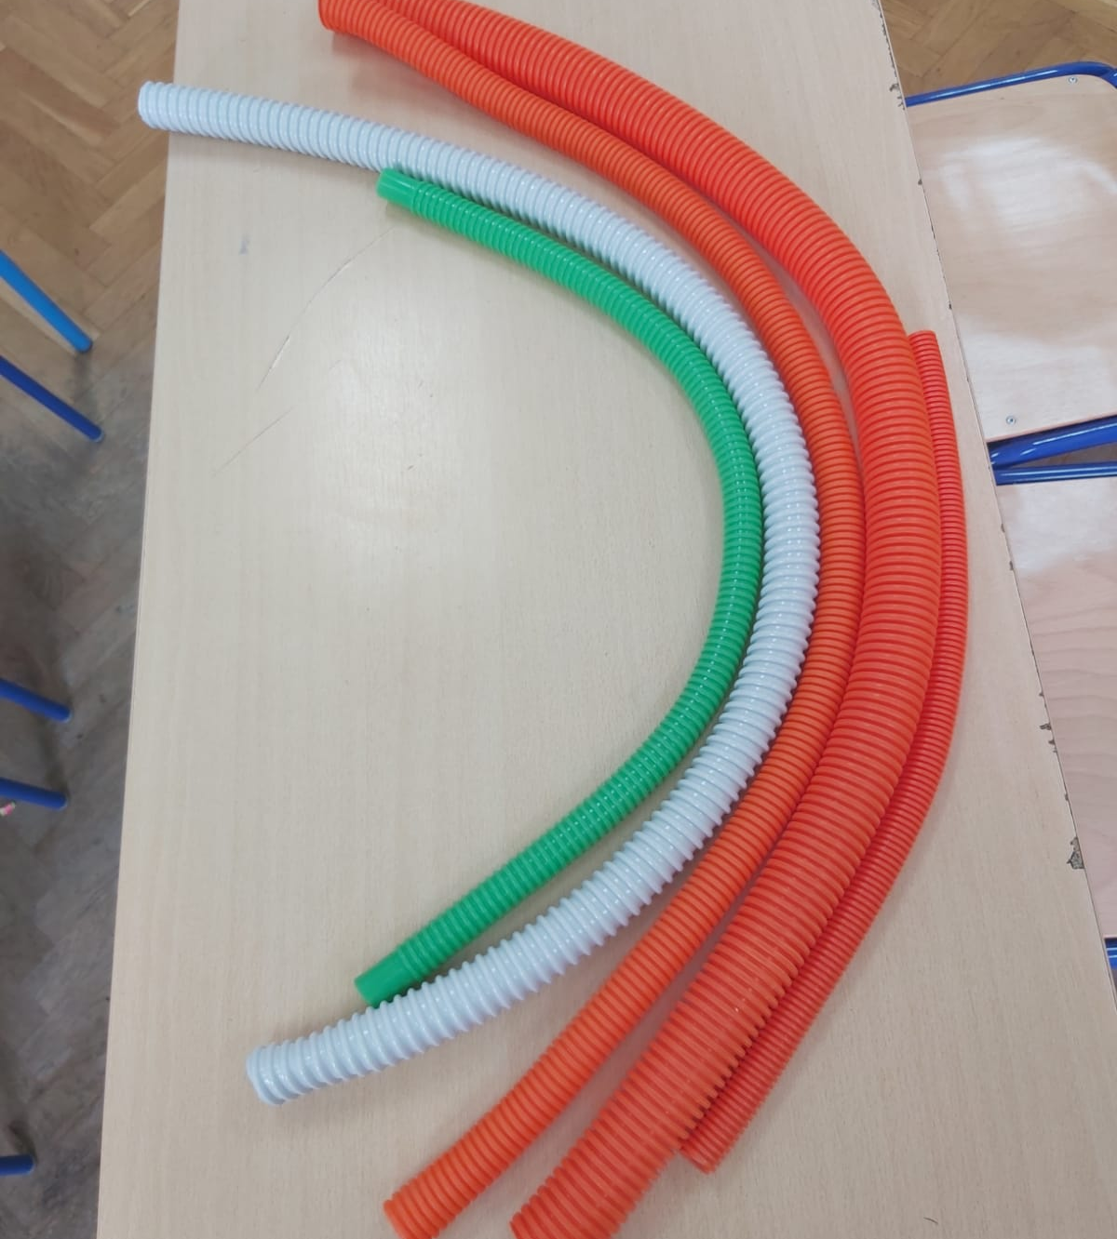
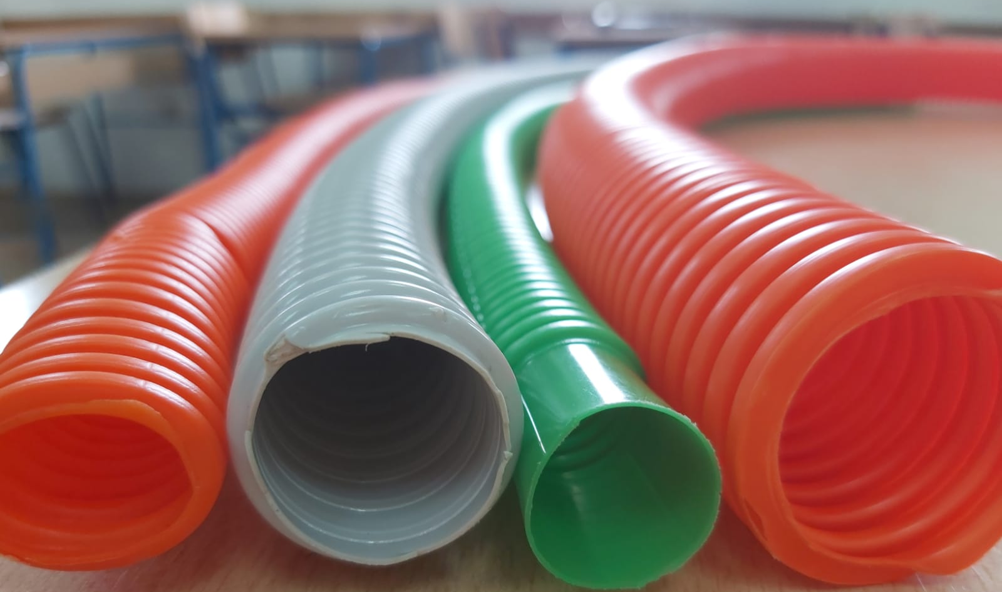
Pipes
Attached is a picture of the tube we worked with.
The pipes have different characteristics (length, wrinkle, thickness )
Notes:
Ovdje je priložena slika cijevi s kojima smo radili. Cijevi su različitih karakteristika (duljina, naboranost, debljina)

Slide 4
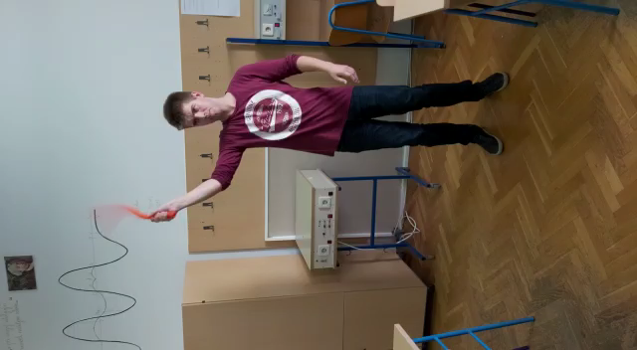
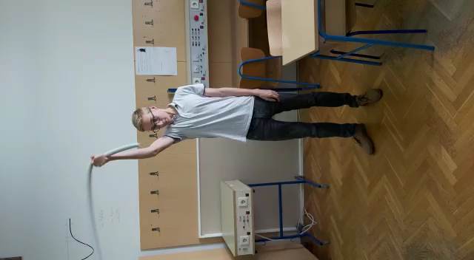
Orange pipe
Gray pipe
Video
Video
As you can see, the gray and orange pipes do not sound the same and the frequency of the pipe changes depending on the speed of rotation.
Notes:
Kao što primjećujete siva i narančasta cijev ne zvuče jednako i frekvencija cijevi se mijenja ovisno o brzini vrtnje.

Slide 5
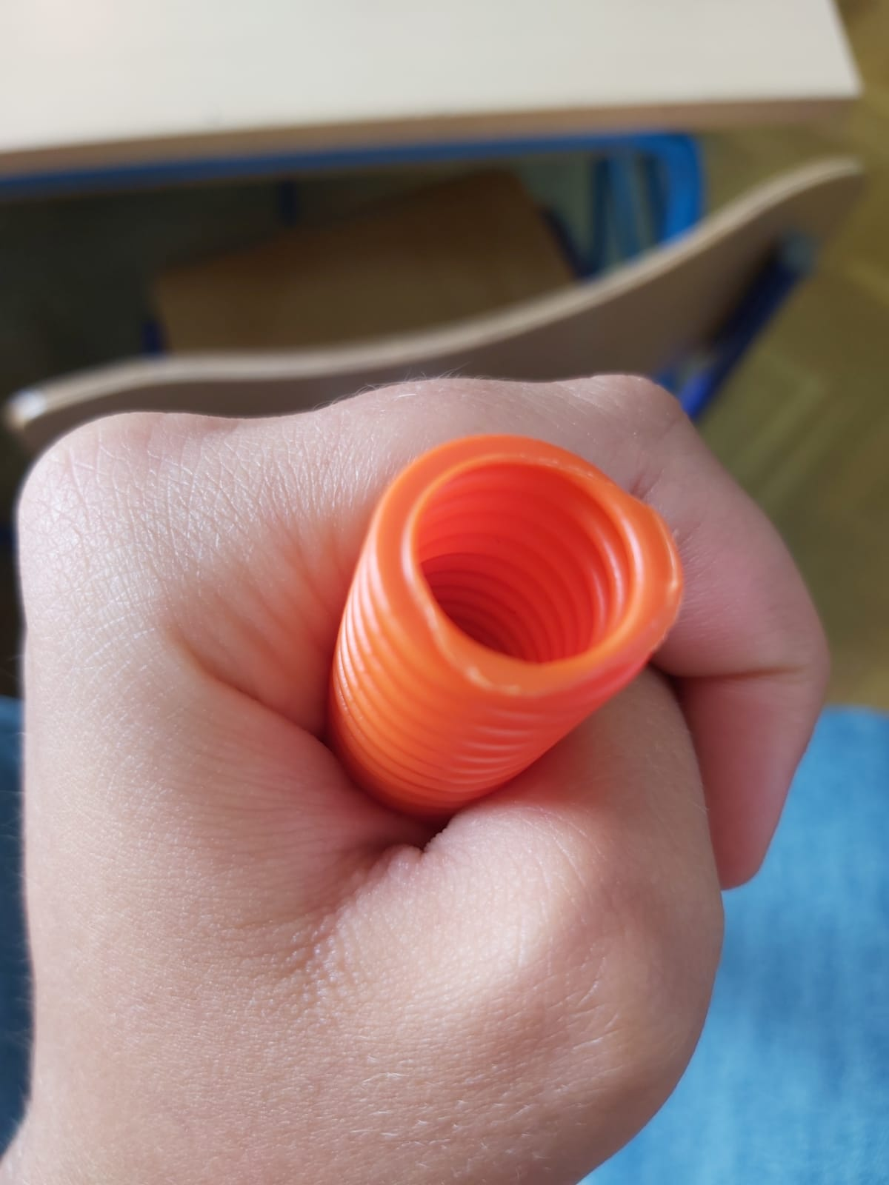
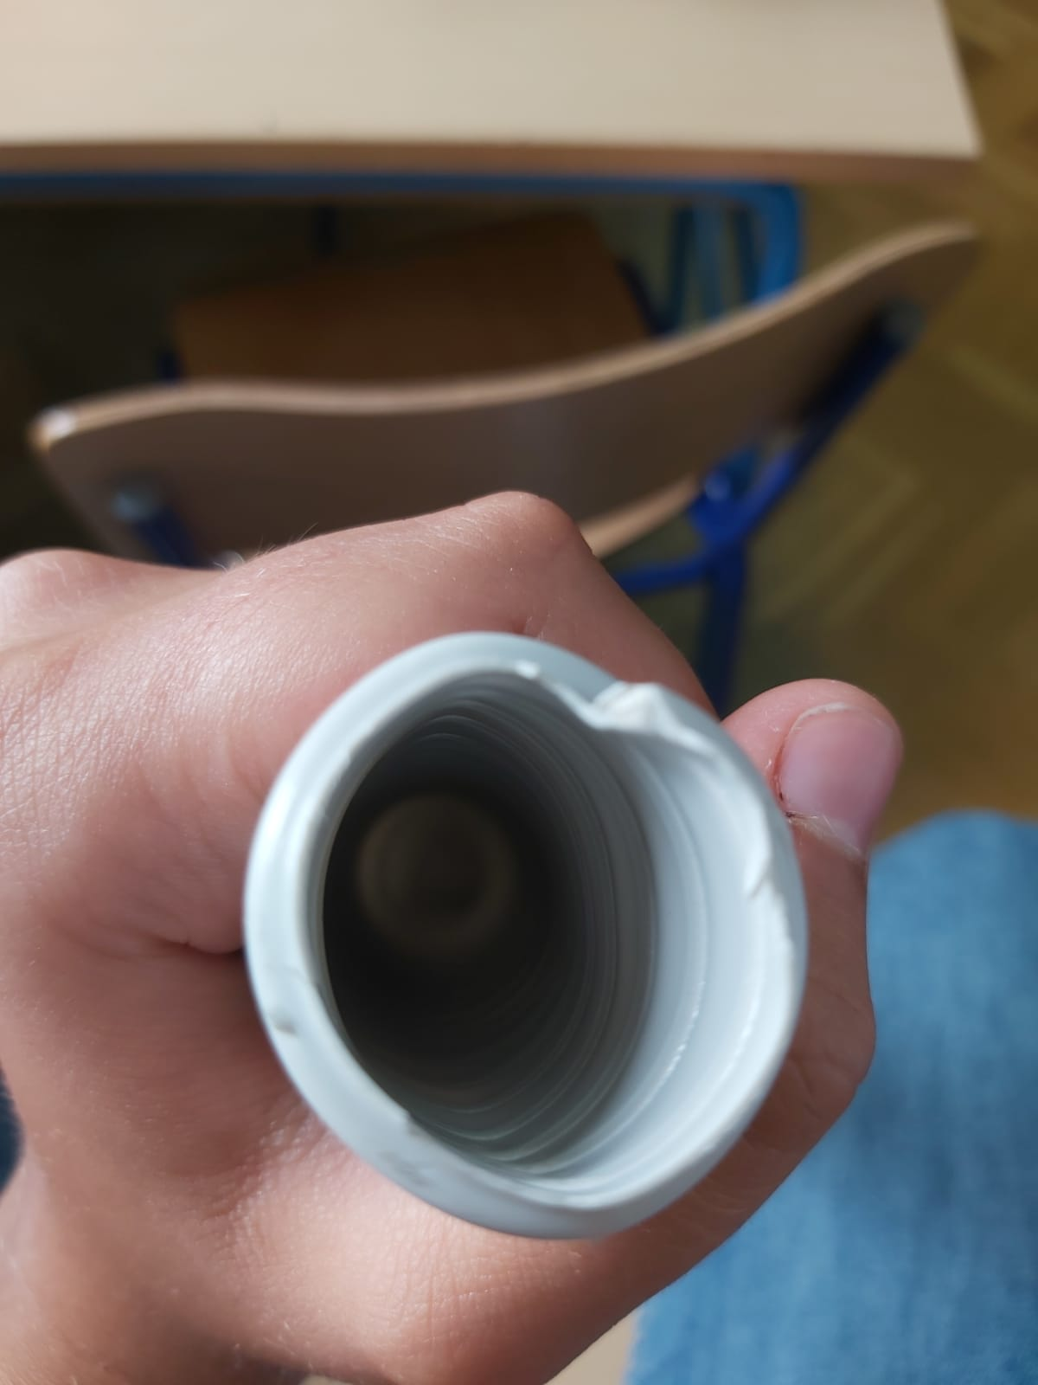
INSIDE THE PIPES
the orange tube is wrinkled on the inside and the gray isn’t not

Slide 6
QUESTIONS
Knowing the Bernoulli principle, standing waves and resonance, try to answer the questions.
Why is the sound generated while spinning?
Why are the different frequencies of the sound being produced?
Why doesn't the gray tube produce sound, regardless of the rotation?
Notes:
Poznavajući bernulijev princip, stojne valove i rezonanciju, pokušajte odgovoriti na pitanja.
Zašto uopće nastaje zvuk za vrijeme vrtnje? Zašto su različite frekvencije zvuka koji nastaje? Zašto siva cijev ne proizvodi zvuk, bez obzira na vrtnju?

Slide 7


AIR FLOW
By rotating the tube the air is drawn in and passes through the tube
Bernoulli Equation
radial velocity
tangential velocity

Slide 8
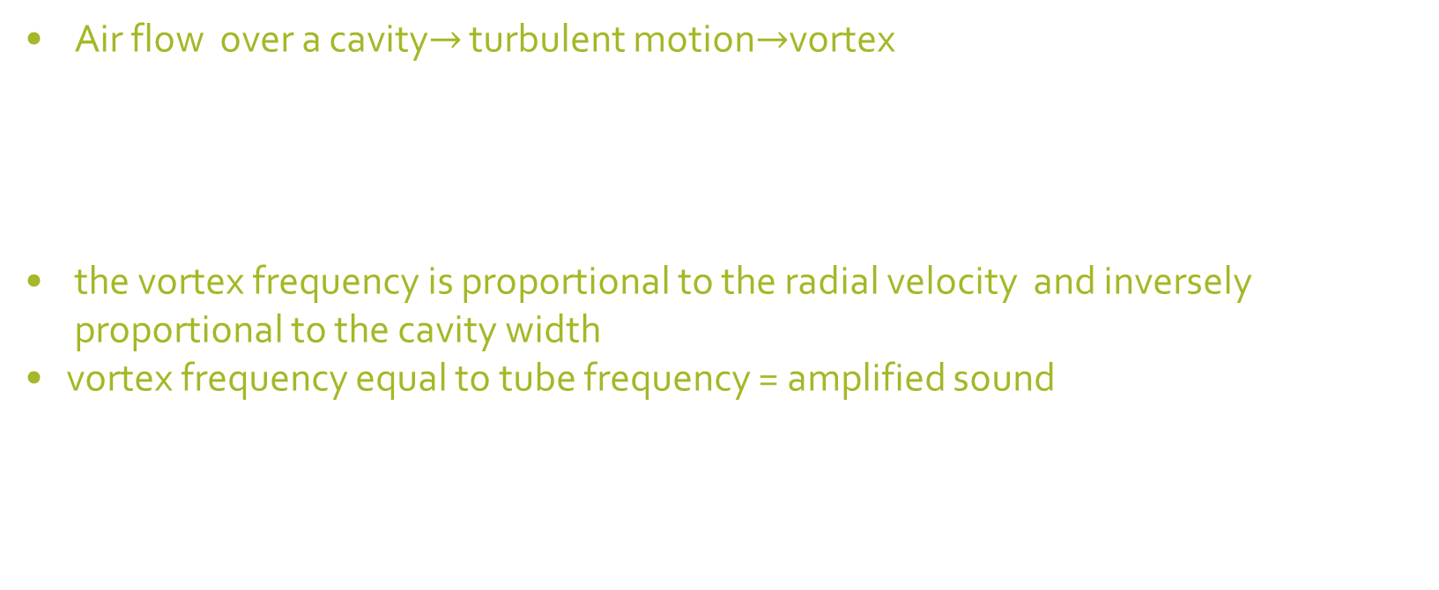
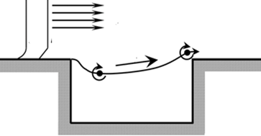
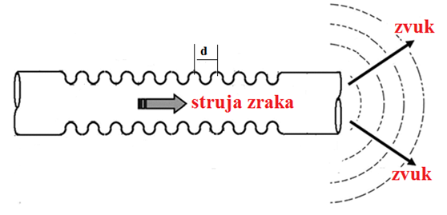
Vortex formation (turbulent flow)

Slide 9
ideal open-ended tube, the resonant modes are given:
for n = 1, 2, 3…, where v is the speed of sound and L is the tube length.
real open-ended tube, the resonant modes are given:
where L_{ef} is effective length
(r is the radius of the tube)
where v_{ef} is effective velocity

